Slide 1
A difficulty analysis of WorldLand consensus algorithm

Slide 2
Motivation
A need for easier difficulty level
The table of current difficulty levels (easiest 4 levels):
level | n | wc | wr | decisionFrom | decisionTo | decisionStep | _ | miningProb
0 | 32 | 3 | 4 | 10 | 22 | 2 | 0.329111 | 3.077970e-05
1 | 32 | 3 | 4 | 10 | 22 | 2 | 0.329111 | 3.077970e-05
2 | 32 | 3 | 4 | 10 | 16 | 2 | 0.329111 | 2.023220e-05
3 | 32 | 3 | 4 | 16 | 16 | 1 | 0.329111 | 9.684650e-06
n: length of codewords.
wc, wr: number of 1s in a column/row of the parity check matrix.
decisionFrom/decisionTo: minimum/maximum Hamming weight of a target codeword
miningProb: corresponding mining success probability

Slide 3
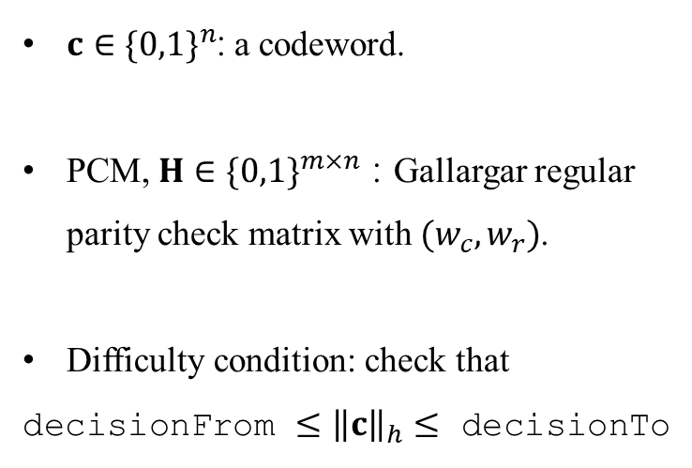
Background
$c∈{\{0,1\}}^{n}$: a codeword.
PCM, $H∈{\{0,1\}}^{m×n}$ : Gallargar regular parity check matrix with $(w_{c},w_{r})$.
Difficulty condition: check that
decisionFrom $≤{\left\|c\right\|}_{h}≤$ decisionTo
Fig. 1. The overall scheme of the consensus algorithm

Slide 4
Background
The consensus algorithm based on an iterative decoding algorithm of low density parity check (LDPC) codes.
Variable nodes and check nodes exchange messages (or probabilities) iteratively, until find a codeword, or reach to the maximum number of iteration.
Fig. 2. The detail of the decoder part

Slide 5
Problem
Question) mining probability is too low.
Pr{mining} = Pr{decoding success & met difficulty condition}
The iterative decoding is known for its high decoding success probability. But the mining probability (3e-5 for ¾ rate code) seems too low here.
level | n | wc | wr | decisionFrom | decisionTo | decisionStep | _ | miningProb
0 | 32 | 3 | 4 | 10 | 22 | 2 | 0.329111 | 3.077970e-05
1 | 32 | 3 | 4 | 10 | 22 | 2 | 0.329111 | 3.077970e-05

Slide 6
Approach 1
Approach 1) we aim to verify the source code of LDPC decoder part
We found that original C++ implementation¹⁾ and Go implementation in WorldLand²⁾ are different.
1) https://github.com/cryptoecc/ECCPoW/blob/master/Blockchain/decoder/LDPC.cpp
2) https://github.com/cryptoecc/ETH-ECC/blob/master/consensus/eccpow/LDPCDecoder.go

Slide 7
Approach 1
In the computing part for check-to-variable (C2V) messages, C++ implementation updates all C2V messages from m check nodes. (As the way LDPC does)
But Go implementation in WorldLand updates C2V messages only from first w_{r} check nodes.
C++ | Go
for (k = 0; k < this->redundancy; k++) { for (l = 0; l < this->row_deg; l++) { temp3 = 0.0; sign = 1; for (m = 0; m < this->row_deg; m++) { if (m != l) { temp3=temp3+func_f(fabs(this->LRqtl[this->col_in_row[m][k]][k])); if (this->LRqtl[this->col_in_row[m][k]][k] > 0.0) temp_sign = 1.0; else temp_sign = -1.0; sign = sign * temp_sign; } } magnitude = func_f(temp3); this->LRrtl[this->col_in_row[l][k]][k] = infinity_test(sign*magnitude); } } | for k := 0; k < parameters.wr; k++ { for l := 0; l < parameters.wr; l++ { temp3 := 0.0 sign := 1.0 tempSign := 0.0 for m := 0; m < parameters.wr; m++ { if m != l { temp3 = temp3 + funcF(math.Abs(LRqtl[colInRow[m][k]][k])) if LRqtl[colInRow[m][k]][k] > 0.0 { tempSign = 1.0 } else { tempSign = -1.0 } sign = sign * tempSign } } magnitude := funcF(temp3) LRrtl[colInRow[l][k]][k] = infinityTest(sign * magnitude) } }

Slide 8
Approach 1
Since Go implementation utilize only small part of information from several check nodes, decoding probability of Go imple. will be lower than that of C++ imple..
We reproduced the two implementation into a single python implementation for comparison under same parameters.
Result for the parameters (n, wc, wr, maximumIteration, crossoverProbability) = (16, 3, 4, 20, 0.01)
 | Original in python | WorldLand in python
Decoding probability | 0.26941 | 0.0010281 (1.0281e-3)

Slide 9
Approach 1
Two Hamming weight distributions are similar.

Slide 10
Approach 2
Approach 2) we aim to verify the mining probability by reproducing the decoding simulation
Since we conclude that current WorldLand is based on ETH-ECC Go implementation, we try to simulate with the python implementation of WorldLand.
However, python is two slow to simulate n = 32 code.
We implemented a Go simulation code using the source code of WorldLand.

Slide 11
Approach 2
Result 2-1: compare with python implementation
The result for (16, 3, 4, 20, 0.01) is equivalent to that of python implementation.
 | WorldLand in Go | WorldLand in python
Decoding probability | 0.0010424 (1.0424e-3) | 0.0010281 (1.0281e-3)

Slide 12
Approach 1
Three Hamming weight distributions are similar.

Slide 13
Approach 2
Result 2-2: compare with difficulty table
The result for (32, 3, 4, 20, 0.01) is too different with the values in current table.
 | WorldLand in Go | Difficulty Table
Decoding probability | 2.525e-7 | Unknown
Mining probability (from 10 to 22) | 2.525e-7 * 0.94059 = 3.4656e-7 | 3.077970e-05
Mining probability (from 16 to 16) | 2.525e-7 * 0.21782 = 5.5e-8 | 9.684650e-06

Slide 14
Conclusion
Decoding algorithm in WorldLand implemenation is different with original (theoretical) implementation.
We could not reproduce the simulation for generating the difficulty table in WorldLand implementation

